Slide 1
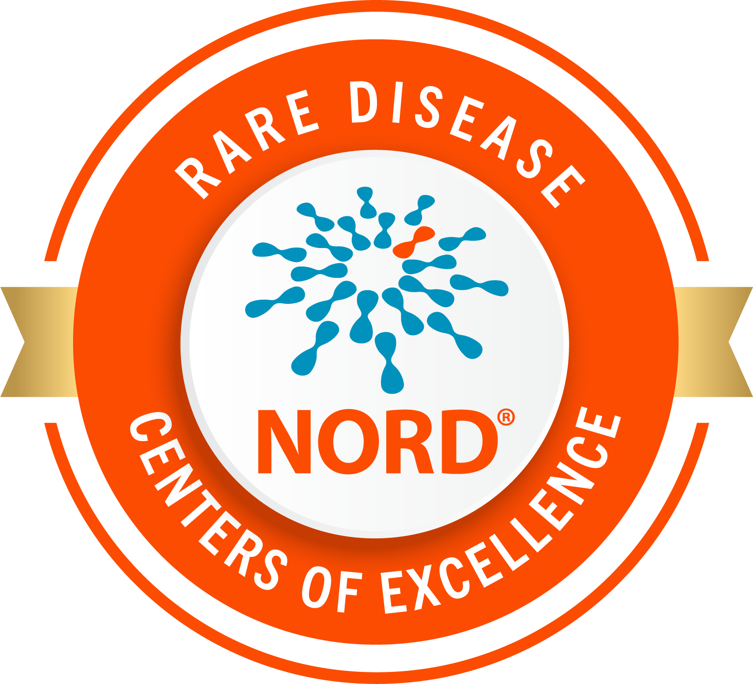


Interested in Rare Disease Research? Explore where you could fit.
NORD’s Rare Research Launchpad is a free,
self-paced online course for students and trainees interested in science, medicine, and research.
Explore:
  Rare disease biology & treatment development
  Research career paths
  Bench-to-bedside translation
  Research experiences & skill building
  Mentorship & networking
!
Includes a free Research Exploration Toolkit for you to use at different stages of your training.
learn.rarediseases.org
Supported by the Rosenau Family Research Foundation

